Slide 1

Holon Institute of Technology
Data Science Project:
Friecipe – Predicting Peoples Taste in Food
Guy Shafir
Sagi Sarussi

Slide 2
Objective
The main objective of the project is to predict peoples taste in food using the website https://allrecipes.com.
AllRecipes is a social network which revolves around food.
Users can share recipes, make connections with other users, review recipes of others and even favorite recipes they like.
AllRecipes is the most popular website in the field, composed of millions of users and myriad of different food recipes.
Friecipe is trying to predict a similarities in the taste of users and find users with fitting taste and even suggest other recipes which they might like based on their taste preferences.

Slide 3
Data Accumulation

Slide 4
Data Accumulation
In order to build the dataset we created a graph by crawling through profiles and their peers using mostly Selenium and a little bit of Requests:
init_driver() – Opens the browser.
wait_for_load() – Waits until the page is fully loaded.
scroll_down_page() – Scrolls down the current loaded page and fetches more items by clicking the "More" button.
scrape_profile_reviews() - Scrapes reviews from a different profile id.
format_profile_id() – Formats the URL for given id.
scrape_contacts() – Scrapes contacts from a different profile id – followers & following
is_profile_empty() – returns False when the profile id is not empty.

Slide 5
Data Accumulation
In order to build the dataset we created a graph by crawling through profiles and their peers using mostly Selenium and a little bit of Requests:
is_valid_profile() – Returns False when the profile is invalid.
navigate_profile() – Navigate to the given profile id
append_if_unknown() – Checks if a profile was previously visited, if not add it to the visited profiles.
get_id_from_url() - Returns the profile id from the URL.
profile_scraper() – Scrapes the data uses scrape_profile_reviews() and scrape_contacts().
get_review_from_card() – Pulls out the review from every card in each profile

Slide 6
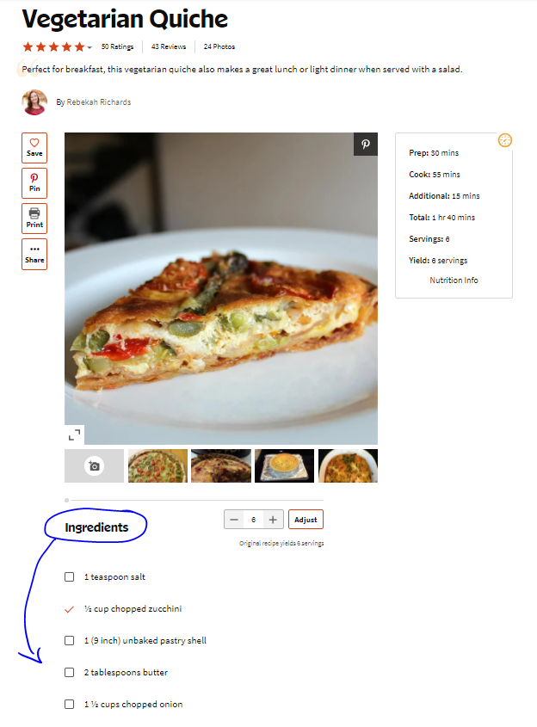
Collecting Data
After we connected to the website we started collecting
data. First we take the ingredients into our database
and by that we built a dataset that has recipes and their
ingredients. The data was later used to predict some similar activity about different profiles in the website.

Slide 7
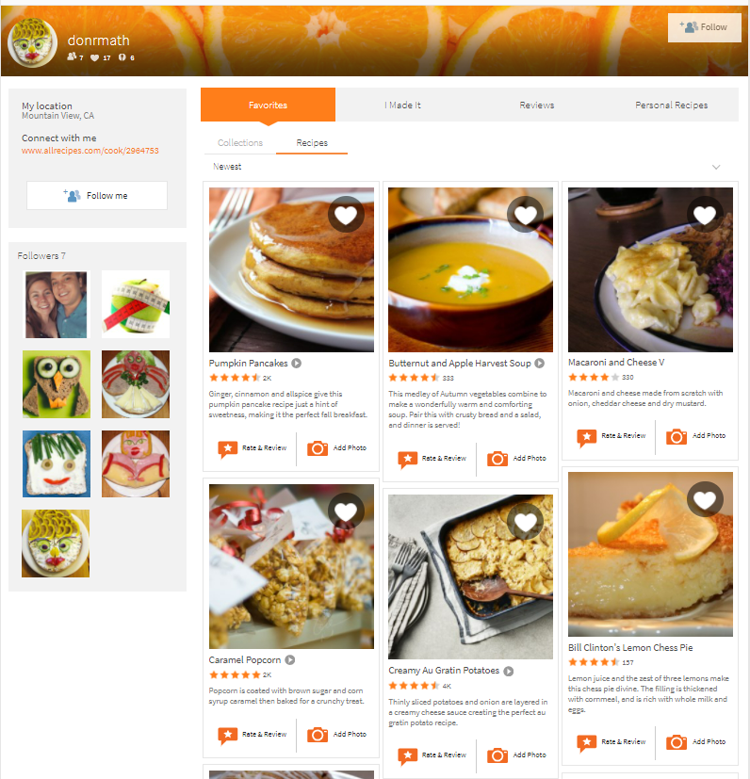
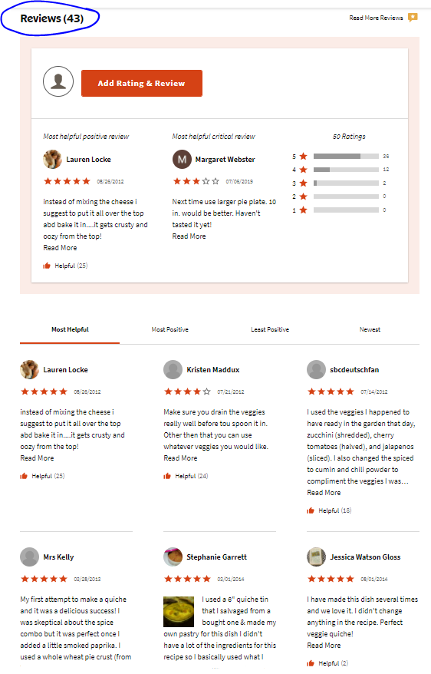
Collecting Data
Other than the peers each profile has, we also scrape other datapoints such as:
Reviews: Linked to a recipe, rates it by a
number between 1 and 5.
Favorites: Boolean value, we decided to
ignore since it is easy for users to just use
it and it renders it meaningless.
Location: For the users whom specified
their location - we also scrape it, used
for further visualizations.

Slide 8
How Our Model Works

Slide 9
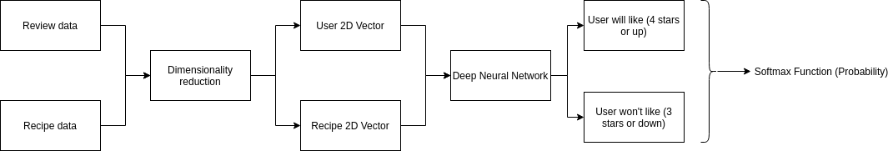
How it Works
Pre Machine Learning.
We take the review and recipe data and we use dimensionality reduction to scale down the number of dimensions of users and recipes we than use deep neural network we combined users and recipes to the vectors and tried to predict whether a given user might or might not likes a given food.

Slide 10
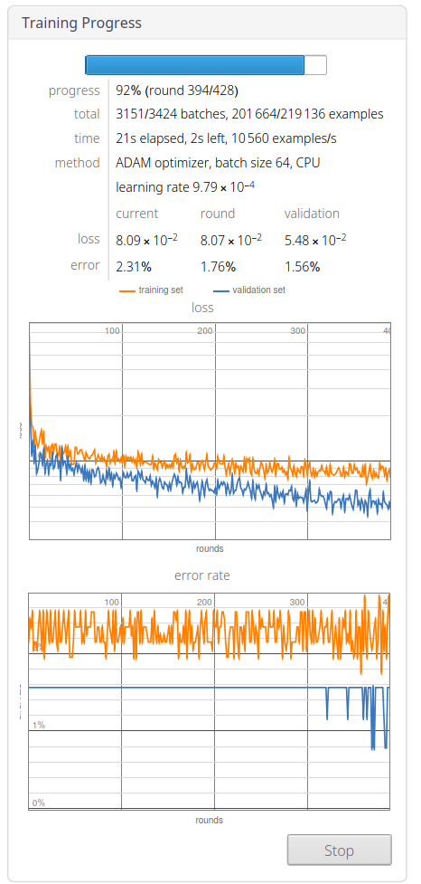
Predicting Taste
Pre Machine Learning.
In order to predict the taste of users we tried to find how their tastes relate by referencing the reviews we collected in previous steps. We used a Deep Learning Neural Network with 6 fully connected linear layers, with ReLU activation functions (called RAMP in Wolfram Mathematica), we separated the data using the 80/20 ratio, before the separation we had 94% success rate, while afterwards the prediction was successful 97% of the time! At last, we used the SoftMax function with the ADAM optimizer.

Slide 11
Pre Machine Learning

Slide 12
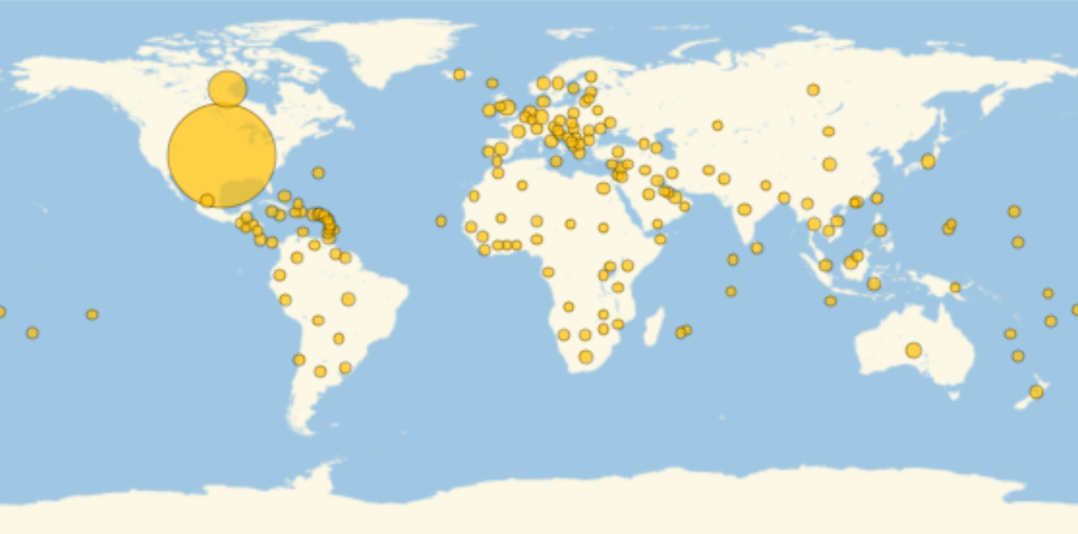
Countries Data
Pre Machine Learning.
Representation of the percentage of users of each country out of the entire userbase:

Slide 13
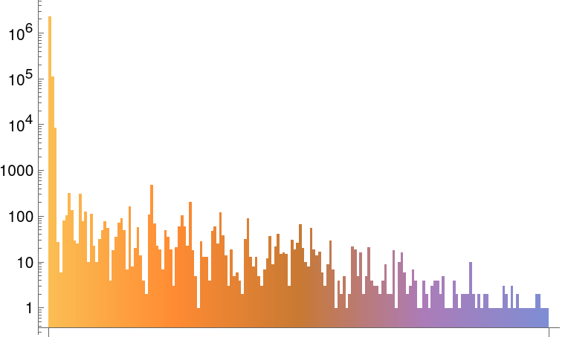
Users Data
Pre Machine Learning.
How many people from each country use the website:

Slide 14
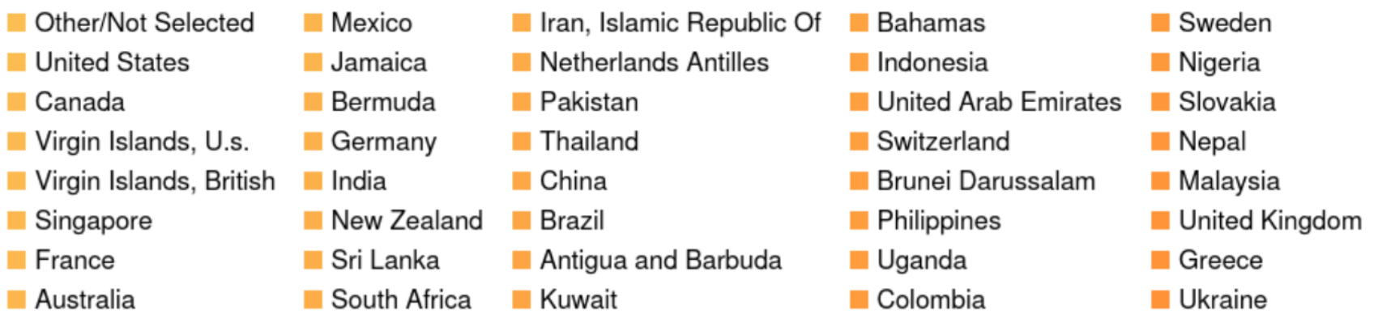
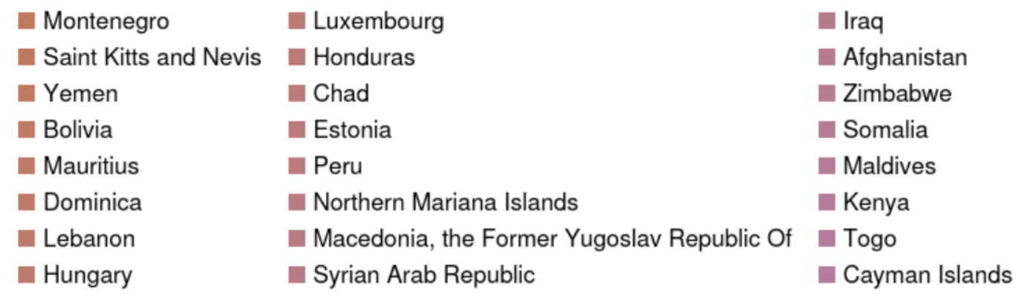
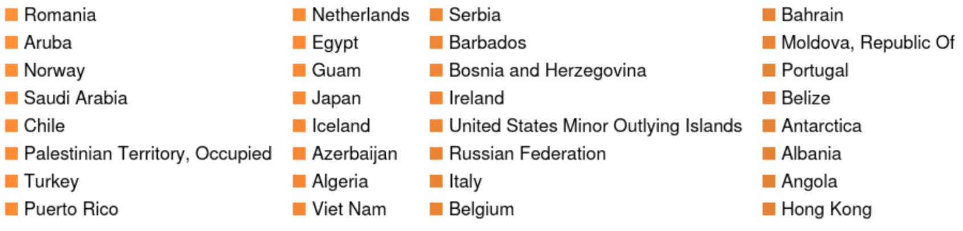
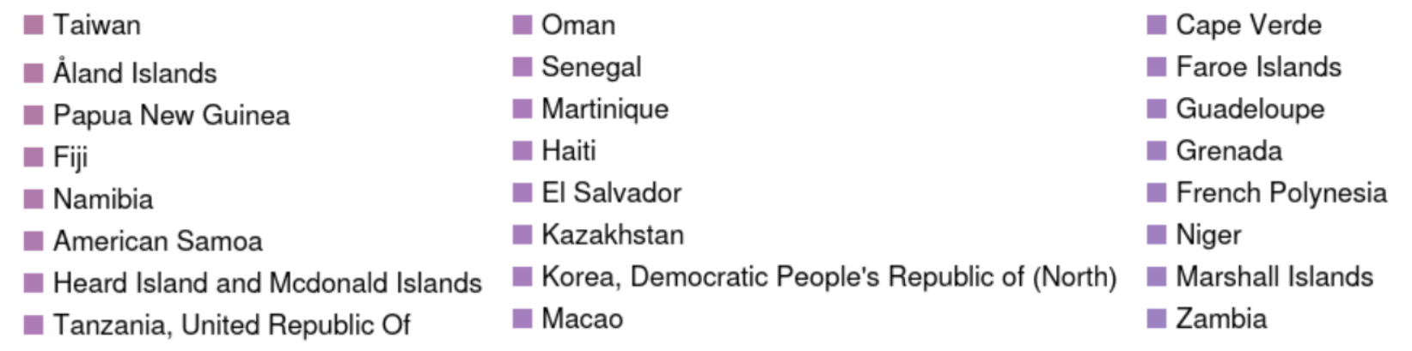
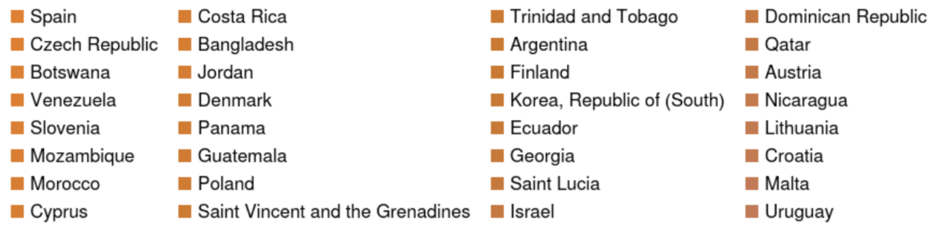
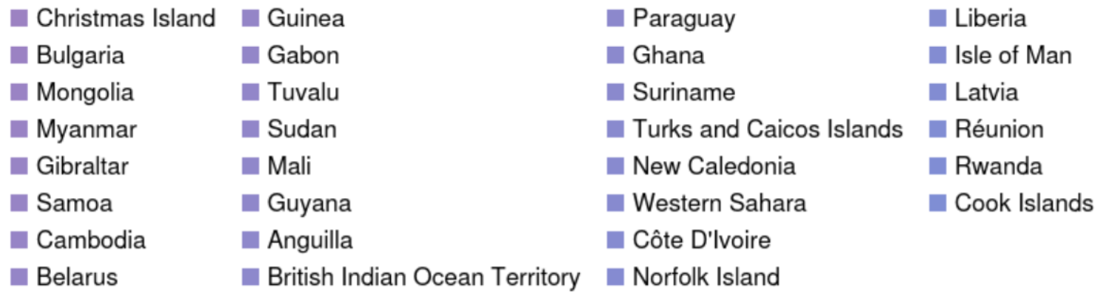
Users Data
Pre Machine Learning.
Continuation of the previous graph, a description of each country in the graph:

Slide 15
Post Machine Learning

Slide 16
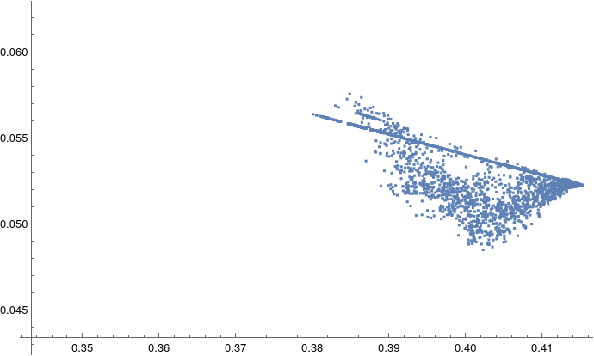
Users Similar Taste
Post Machine Learning.
The following graph shows the relative distance between users after vectorization, by noting how they rated the reviews the wrote.

Slide 17
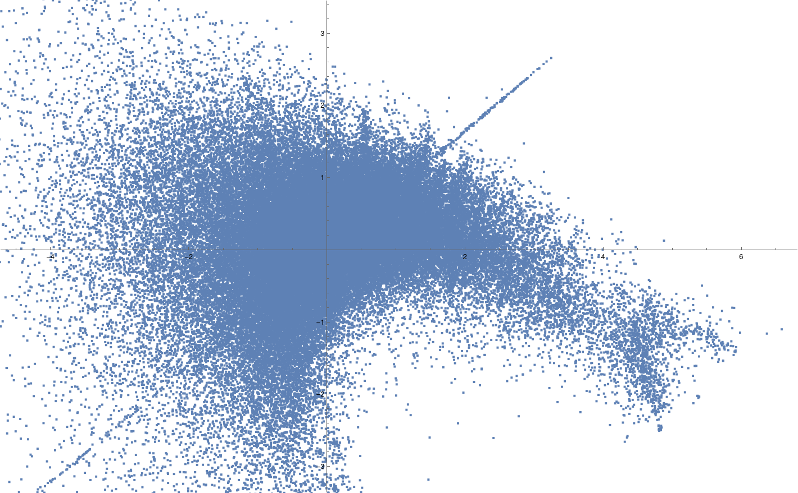
Similar Recipes
Post Machine Learning.
The following graph shows the relative distance between recipes after vectorization, by vectorizing their ingredients.

Slide 18
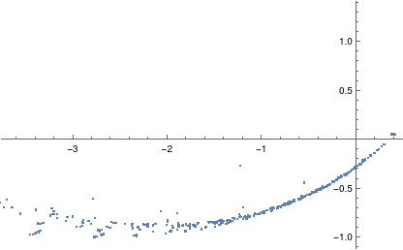
American Customers Tastes
Post Machine Learning.
This is the positions of U.S. users, The following graph represents how American customers' tastes fragments

Slide 19
Recipe Recommendation Demonstration

Slide 20
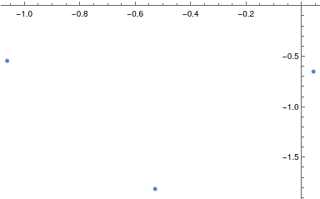
American Customers Tastes
Post Machine Learning.
Plotting of the three vectorized input recipes

Slide 21
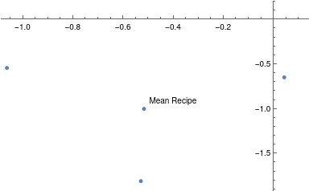
American Customers Tastes
Post Machine Learning.
Three input recipes + mean value

Slide 22
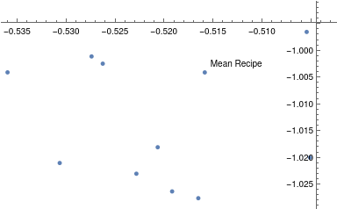
American Customers Tastes
Post Machine Learning.
Mean value + 10 nearest recipes to the mean value (excluded input ones)

Slide 23
Conclusions

Slide 24
Conclusions
We have created a model that represents similar tastes between people and between recipes, according to the graphs we can see some sequence between all recipes and users, there is a clear tendency that shows similar ingredients and users
taste, then we used DL (Deep Learning) to predict the taste of a given user.
According to the sequence we can conclude that there are some groups that likes
same food and this are the dots that actually close to each other.
But if we’ll take a few dots that doesn't seem to be next to each other, it means that
there is a big difference between the ingredients or the taste.
According to recipe recommendation demonstration we can conclude that it’s possible to use webs scraped data to build a real world application.

Slide 25
References

Slide 26
References
[1] - https://www.allrecipes.com/
[2] - https://stackoverflow.com/
[3] - https://stackexchange.com/
[4] - https://www.selenium.dev/documentation/en/
[5] - https://reference.wolfram.com/language/
[6] - https://pymongo.readthedocs.io/en/stable/
[7] - https://numpy.org/doc/
[8] - https://campus.gov.il/
[9] - https://docs.docker.com/

